Slide 1























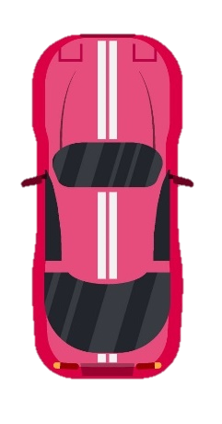
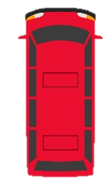

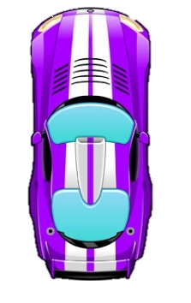
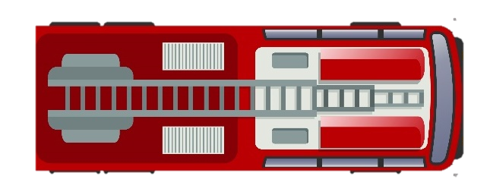

PD Learning Journey
Year 7 to Year 11
Post-16
SUMMER EXAM SEASON
LEAVING
- YEAR 11 -
REVISION
FINAL EXAMS
YEAR
11
Health and wellbeing – Building for the future
Living in the wider world – Next steps
Relationships – Communication in relationships
Health and wellbeing – Independence
Relationships – Families
Cohort Opportunities
- Opportunity Days - Enrichment activities - Student Parliament Election - Student Leadership
- Information Evening - Post-16 Careers Fair
- Open Days - Elevate Revision Sessions
- Revision classes - Career interviews
- Career and Apprenticeship Week
Cohort Opportunities
- Opportunity Days - Enrichment activities - Reward Trip - Echo Eternal event participation - CORE Leaders of Tomorrow - Echo Eternal performance
- D of E Bronze Recruitment - Football Beyond Borders
- Mathletics Challenge - Speak Out Challenge
- Prefect and Leadership applications - Work Experience
- Aim Higher Mentoring - Career interviews
Health and wellbeing – Mental health
Living in the wider world – Financial decision making
Relationships – Healthy relationships
Health and wellbeing – Exploring influence
Relationships – Addressing extremism and radicalisation
Living in the wider – Work experience
YEAR
10
YEAR
9
Health and wellbeing – Peer influence, substance and gangs
Living in the wider world – Setting goals
Relationships – Respectful relationships
Health and wellbeing – Healthy lifestyle
Relationships – Intimate relationships
Living in the wider – Employability skills
Cohort Opportunities
- Opportunity Days - Enrichment activities - Reward Trip - Echo Eternal event participation - GCSE options - Echo Eternal performance
- D of E Bronze Recruitment - Football Beyond Borders
- Mathletics Challenge
Cohort Opportunities
- Opportunity Days - Enrichment activities - Reward Trip - Echo Eternal event participation - Brilliant Club - Echo Eternal performance
- CCF Recruitment - STEM assembly - Student Parliament Election
Health and wellbeing – Drugs and alcohol
Living in the wider world – Community and careers
Relationships – Discrimination
Health and wellbeing – Emotional wellbeing
Relationships – Identity and relationships
Living in the wider – Digital literacy
YEAR
8
YEAR
7
Health and wellbeing – Transition and safety
Living in the wider world - Developing skills and aspirations
Relationships – Diversity
Health and wellbeing – Health and puberty
Relationships – Building relationships
Living in the wider – Financial decision making
Cohort Opportunities
-Opportunity Days - Year 6 Transition Ambassadors
-Enrichment activities - Reward Trip
-Echo Eternal event participation - Brilliant Club
-Echo Eternal performance - Student Parliament Election
WELCOME
RSE COMPLIANT
PSHE
Long –Term Overview
Autumn 1 – Health and wellbeing
Autumn 2 – Living in the wider world
Spring 1 - Relationships
Spring 2 – Health and wellbeing
Summer 1 - Relationships
Summer 2 – Living in the wider world
PERSONAL DEVELOPMENT
ASSESSMENT & PROGRESS IN PSHE
HEALTH COMPLIANT
Confidence Checkers
End of Unit Quizzes
Self Assessment
GATSBY BENCHMARKS

